Slide 1
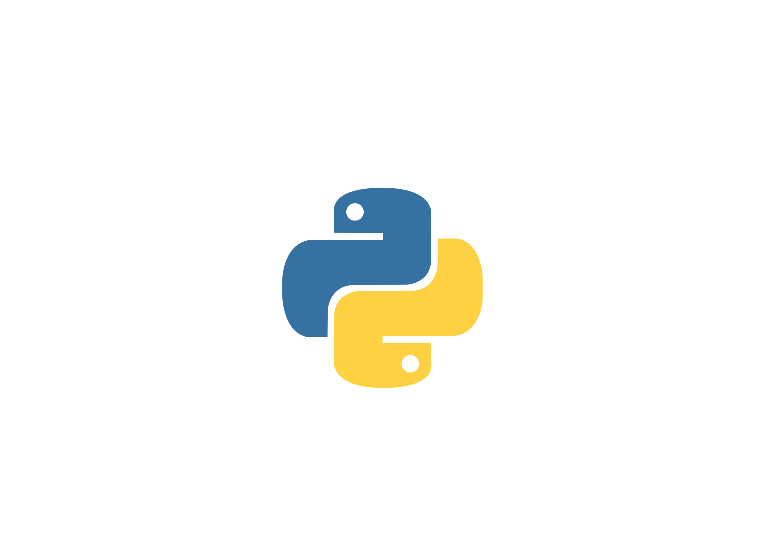
Conditional Statement

Slide 2
Conditional Statement
Conditional expression allows our program to make decisions.
Every decision is taken with a Boolean expression which yields either true(1) or false (0) value.
Conditional statements are handled by if statements in Python.
The form of the if statement is in figure (a).
if condition: statement1 else: statement2
>>> 5 >=3 True >>> 4 > 8 False
Figure (a)
Figure (b)

Slide 3
if statement
Logical conditions such as equals (==), not equals (!=), less than (<), greater than (>) and so on are used by if statements.
If statements can further be implemented with else, elif and nested conditions.
The simple example using conditional
if statement to compare whether the
value of variable satisfies the criteria or
not.
>>> pcr_test = '-ve' >>> if pcr_test == '+ve': ... print("Patient is infected by virus") ... else: ... print("Test result is found negative") ... Output: Test result is found negative
Figure: A simple example for if statement

Slide 4
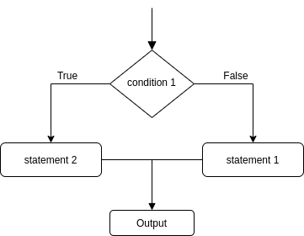
if Statement Flow Chart
Figure: Flow Chart of If statement

Slide 5
if/else, if/elif/else statement
We can easily create a chain of if statements.
Once a condition satisfies the criteria then no other code blocks are executed. (in order from top to bottom)
In a figure, each statement is mutually exclusive which means it cannot occur at the same time.
It is either condition1 or condition2 or condition 3 and so on.
if (condition1): condition 1 statements elif (condition2): condition 2 statements elif (condition3): condition 3 statements else: statement 4
Figure: if-else if-else chain

Slide 6
if/else, if/elif/else statement ...
It is also possible to create non mutually exclusive statements.
Here, condition 1 and condition 2 can satisfy at the same time.
The else binds to the nearest if only. For example condition 3 if is bounded to the else condition.
if (condition1): condition 1 statements if (condition2): condition 2 statements if (condition3): condition 3 statements else: statement 4
Figure: if and if-else

Slide 7



Ternary if statement
We can simply create a one line if else statement.
[on_true] if [condition] else [on_false]
>>> person = 69 >>> print("The person's age is more vulnerable to virus infection") if person>=65 else print("The person can still get infected") Output: The person's age is more vulnerable to virus infection
Action 1 Statement applies
If condition is true
Condition
Person >= 65
Action 2 Statement applies
If condition is false

Slide 8
Nested if statement
if(condition1): if(condition2): Statement 1 else: Statement 2 else: Statement 3
Nested scenario occurs when an if else statement is present inside the body of another “if” or “else”.
It is better used to test a combination of conditions before making a proper decision.
Figure: Nested if-else

Slide 9
Task
Write a program to input a number and check whether the number is odd or even.

Slide 10
Task
For the first 30 integers, print the number as it is as otherwise, “Fizz” if the number is a multiple of 3, “Buzz” if the number is a multiple of 5 and “FizzBuzz” if the number is the multiple of both 3 and 5.
Output
FizzBuzz …
1 …
2 14
Fizz FizzBuzz
4 16
Buzz …

Slide 11
Task
Write a Program (WAP) to input three numbers and find the greatest number among three.

Slide 12
Task
Write a program to prompt for a score between 0.0 and 1.0. If the score is between 0.0 and 1.0, print a grade using the following table:
A for >=0.9
B for >=0.8
C for >=0.7
D for >=0.6
F for <0.6
If the user enters a value out of range, print a suitable error message.

Slide 13
Python Loops

Slide 14
Loops in Python world
Loops help you to execute a block of code repeatedly
Python world has two types of loops:
For loop
While loop

Slide 15
For loop
For loop is used for iterating over a sequence (that is either a list, a tuple, a dictionary, a set, or a string).
Syntax:
var takes the value of the item inside the sequence on each iteration
Loop continues through every item in the sequence until and unless we break it using the break keyword
for var in sequence:
body of loop

Slide 16
For loop: the difference
for statement in Python differs a bit from what we may be used to in C or Pascal.
Unlike needing an arithmetic progression of numbers (as Pascal) or needing iteration step and halting condition (as C), for statement in python iterates over the items of any sequence.

Slide 17
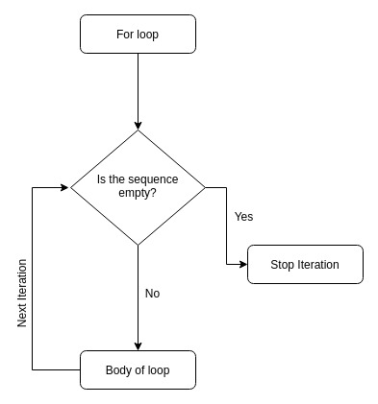
Flow chart of for loop:
Fig: for loop flow chart

Slide 18
For loop examples:
Using any sequence:
>>> for x in [1,2,'a']:
... print(x)
...
1
2
a
>>> for x in "hey":
... print(x)
...
h
e
y

Slide 19
range() function:
Built-in function used to generate a sequence of numbers.
range() in Python(3.x) is just a renamed version of a function called xrange() in Python(2.x)
Syntax:
start: integer starting from which the sequence of integers is to be returned
stop: integer before which the sequence of integers is to be returned, range of integers end at stop – 1.
step_size: integer value which determines the increment between each integer in the sequence
range(start, stop, step_size)

Slide 20
range() function examples:
>>> range(5) # this gives you a range object
range(0,5)
>>> list(range(5)) #lets convert it to a list to see the items
[0, 1, 2, 3, 4] # default start arg is 0 and stop arg is 5 i.e stops at 5-1
>>> list(range(5, 10)) #start arg is 5, stop is 10
[5, 6, 7, 8, 9]
>>> list(range(5, 10, 2)) #using 2 as step_size
[5, 7, 9]

Slide 21
For loop and range() function:
>>> for x in range(5):
... print(x)
...
0
1
2
3
4
>>> for _ in range(2):
... print("hello world")
...
hello world
hello world

Slide 22
For loop and range() function:
>>> for x in range(5, 10):
... print(x**2) #prints squares from 5 to 9
...
25
36
49
64
81

Slide 23
Task
WAP to prompt the user for hours and rate per hour using input to compute gross pay. Pay the hourly rate for the hours up to 40 and 1.5 times the hourly rate for all hours worked above 40 hours.
Use 45 hours and a rate of 10.50 per hour to test the program (the pay should be 498.75). You should use input to read a string and float() to convert the string to a number.

Slide 24
enumerate() function:
Built-in function adds a counter to an iterable and returns it in a form of enumerate object
allows you to loop over a collection of items while keeping track of the current item’s index in a counter variable.
Syntax:
Iterable: any object that supports iteration
start: the index value from which the counter is to be started, by default it is 0
enumerate(iterable, start = 0)

Slide 25
enumerate() function examples:
>>> seq = ['a', 'b', 'c', 1, 2, 3]
>>> enumerate(seq) #returns enumerate object
<enumerate object at 0x7ff641987990>
>>> list(enumerate(seq)) # convert into a list
[(0, 'a'), (1, 'b'), (2, 'c'), (3, 1), (4, 2), (5, 3)]
As we can see, enumerate returns an enumerate object
When we convert the enumerate object to a list, we can see that it has added a counter in each of the element in the sequence
>>> list(enumerate(seq, 1)) # index starts from 1 instead of 0
[(1, 'a'), (2, 'b'), (3, 'c'), (4, 1), (5, 2), (6, 3)]

Slide 26
enumerate() function with loop:
>>> seq = ['a', 'b', 'c', 'd', 'e']
>>> for index, value in enumerate(seq):
... print(f"index: {index}, value: {value}")
...
index: 0, value: a
index: 1, value: b
index: 2, value: c
index: 3, value: d
index: 4, value: e
As you can see, it iterated over the list named seq and generated an index for each element by increasing a counter variable starting at zero.

Slide 27
enumerate() function with loop:
We can change the default start index as shown in previous example, let's set it to 2 in this example
>>> seq = ['a', 'b', 'c', 'd', 'e']
>>> for index, value in enumerate(seq, 2): #indexing starts from 2 instead of 0
... print(f"index: {index}, value: {value}")
...
index: 2, value: a
index: 3, value: b
index: 4, value: c
index: 5, value: d
index: 6, value: e

Slide 28
while loop (Indefinite Iteration)
while loop executes a set of statements as long as a condition is true.
Syntax:
expression is condition that translates to either True or False
body of loop contains the code block you want to execute if expression satisfies
while condition:
body of loop

Slide 29
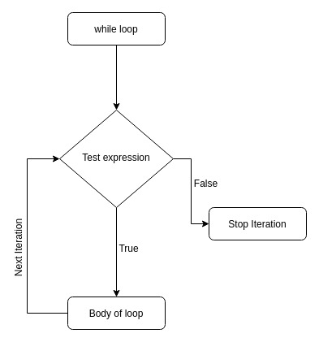
Flow chart of while loop:
Fig: while loop flow chart

Slide 30
while loop example:
>>> counter = 0
>>> while counter < 5:
... counter += 1
... print(counter)
...
1
2
3
4
5

Slide 31
while loop example:
Sequences can also be used:
In each iteration, an item is popped
In the last iteration, the sequence is empty, hence loop stops.
>>> seq = [1,2,3, 'loop', 'testing']
>>> while seq:
... seq.pop()
...
'testing'
'loop'
3
2
1

Slide 32
Control Statement

Slide 33
Control Statement in Python
Used to alter the flow of code block in which it is being used
Supported control statements in Python are:
Break Statement
Continue Statement
Pass Statement

Slide 34
Break Statement
Used to terminate the loop or statement in which it is present
Syntax:
After the execution of statement, control is passed to the available code block
In case of nested loops only the loops containing statement will terminate
break
break
break

Slide 35
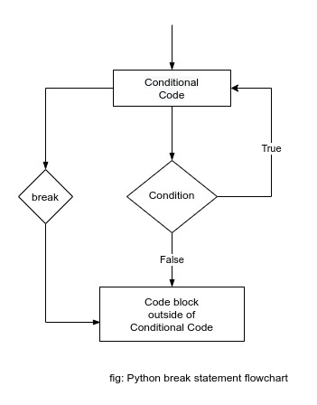
Break Statement (Flowchart) ...

Slide 36
Break Statement (example) ...
To illustrate the break statement example, let's investigate the following problem:
You are told to scan each character of the word "PYTHON" and print it in the console. Later you are told to skip the scanning of character once the vowel letter was found in the word.
Let's get into the solution:
>>> word = "PYTHON"
>>> for _ in word:
... if _.lower() in ['a', 'e', 'i', 'o', 'u']:
... break
... print(i)
...
>>>
>>> # The result printed in console is:
P
Y
T
H

Slide 37
Break Statement (example) ...
Using break statement in while loop
>>> counter = 0
>>> while True:
... print(counter)
... counter += 1
... if counter == 5:
... break
... print('Inside while loop')
...
0
Inside while loop
1
Inside while loop
2
Inside while loop
3
Inside while loop
4

Slide 38
Continue Statement
Used to skip the current execution of loop or statement following the continue statement and the next iteration of the loop or statement will start
Syntax:
Forces to execute next iteration rather than terminating
continue

Slide 39
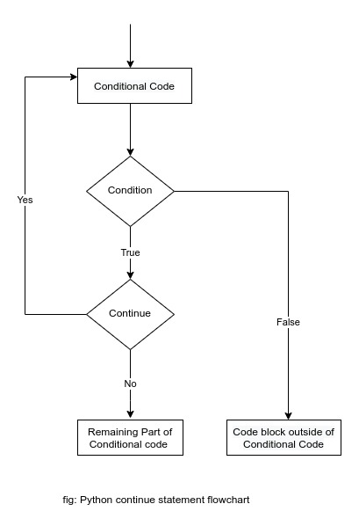
Continue Statement (Flowchart) ...

Slide 40
Continue Statement (example)...
We will follow the same structure as in the previous slide for the example.
To illustrate the continue statement example, let's investigate the following problem:
You are told to scan each character of the word "PYTHON" and print it in the console. Later you are told not to print vowel letters in the word.
Let's get into the solution:
>>> word = "PYTHON"
>>> for c in word:
... if c.lower() in ['a', 'e', 'i', 'o', 'u']:
... continue
... print(c)
...
>>> # The result printed in console is:
P
Y
T
H
N

Slide 41
Continue Statement (example) ...
Using continue statement in while loop
>>> counter = 0
>>> while counter < 5:
... counter += 1
... if counter == 3:
... continue
... print(counter)
...
1
2
4
5

Slide 42
Pass Statement
Placeholder for future code
Used when statement is required syntactically but execution of the code is not wanted
Like null operation (as nothing happens when executed, no errors will raise)
Used to create empty control statement, function and classes.
Syntax:
pass

Slide 43
Pass Statement (example)...
>>> word = "PYTHON"
>>> for c in word:
... if c.lower() in ['a', 'e', 'i', 'o', 'u']:
... pass
... print(c)
...
>>> # The result printed in console is:
P
Y
T
H
O
N
Same thing will happen if we use inside while loop.

Slide 44
Pass Statement (example)...
Using pass statement to create empty class and function
>>> # creating empty function
>>> def func():
... pass
>>>
>>> print(help(func))
Help on function func in module __main__:
func()
None

Slide 45
Pass Statement (example)...
>>> # creating empty class
>>> class A:
... pass
>>>
>>> print(help(A))
Help on class A in module __main__:
class A(builtins.object)
| Data descriptors defined here:
|
| __dict__
| dictionary for instance variables (if defined)
|
| __weakref__
| list of weak references to the object (if defined)
None

Slide 46
More on Control Statement
else statement supported in python with a loop statement
else statement is executed once the for loop gets exhausted iteration and in case of while loop, when the condition becomes false.
>>> word = 'PYTHON'
>>> for c in word:
... print(c)
... else:
... print('Inside else, outside for')
...
P
Y
T
H
O
N
Inside else, outside for
>>> counter = 0
>>> while counter < 4:
... print(counter)
... counter += 1
... else:
... print("Inside else, outside while")
...
0
1
2
3
Inside else, outside while

Slide 47
Iterators And Iterables

Slide 48
Introduction (Iterator)
In Python iterators are objects which can be iterated upon.
We can define iterators as objects that can be used with 'for in loop'.
Iterator follows the iterator protocol:
Iterator must implement __iter__() method
Iterator must implement __next__() method
(we will cover these magic methods later)

Slide 49
Introduction (Iterable)
Iterable objects in Python are objects from which we can get iterator.
Strings, Lists, Tuples, Dictionaries, and Sets are the built-in iterable objects.
All the iterable objects have __iter__() method.
We can use the function iter() (which will call __iter__() eventually) on iterable object to get an iterator.

Slide 50
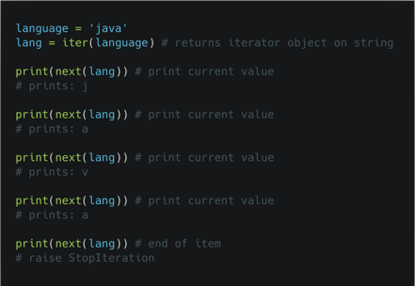
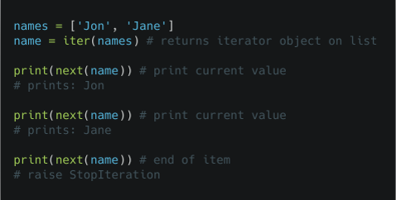
Iterating through an Iterator
next() function is used on iterator (which will call __next__() method eventually) to manually iterate through all the items of an iterator.
Once all the items have been returned by next() (no data for iteration), then it will raise StopIteration.
Iterating through an Iterator (list) example
Iterating through an Iterator (string) example

Slide 51
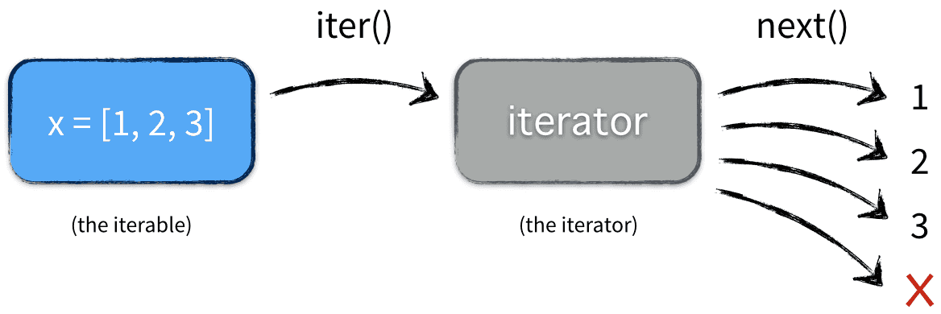
Iterable and Iterator in a nutshell

Slide 52

How for loop works in Python?
One thing before starting, for loop is just syntactic sugar for a simple while loop.

Slide 53
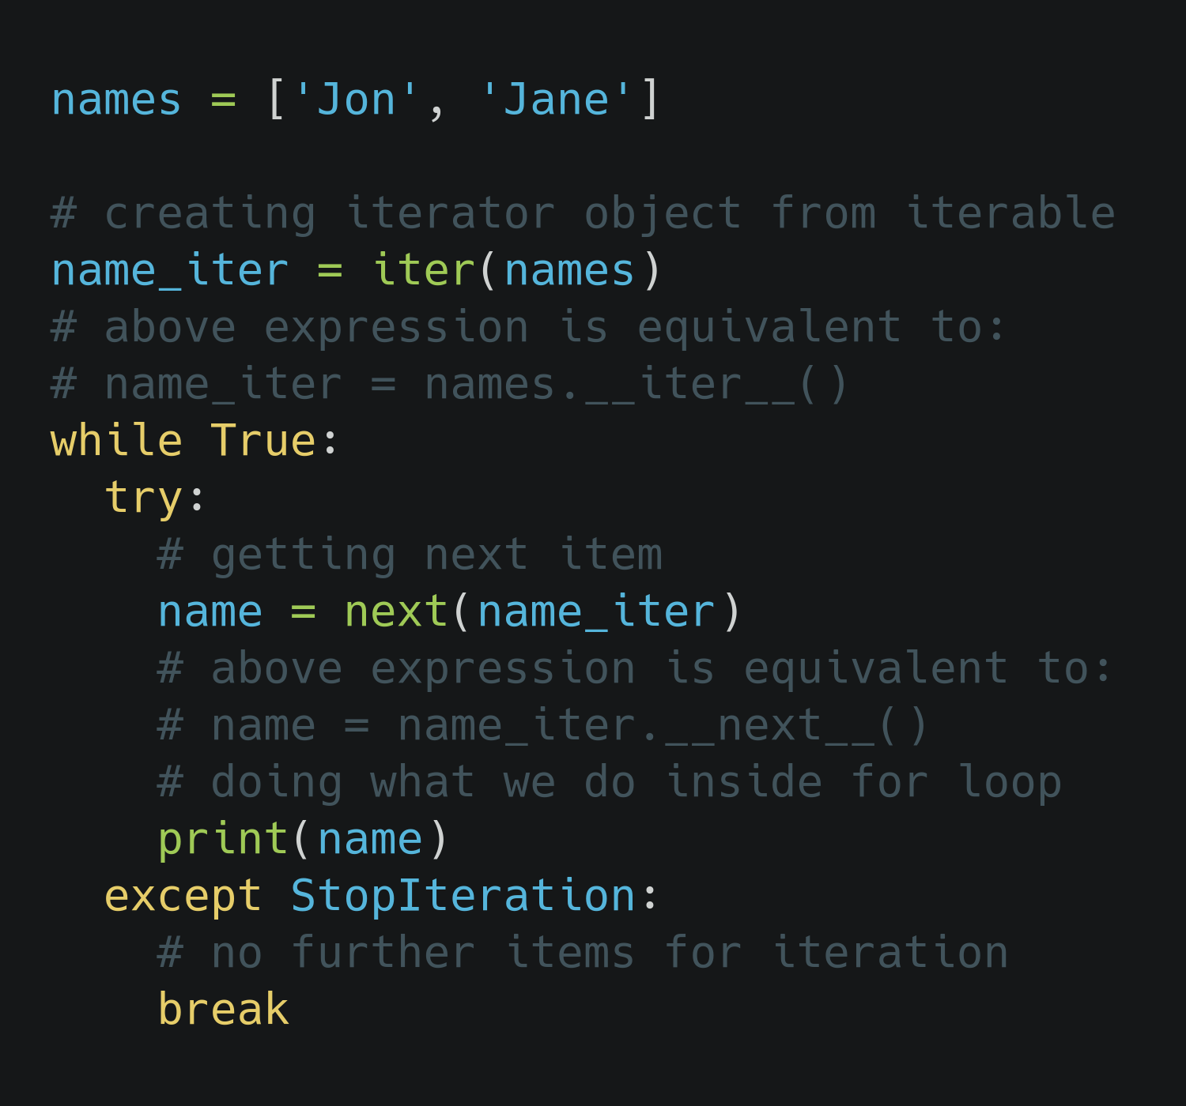
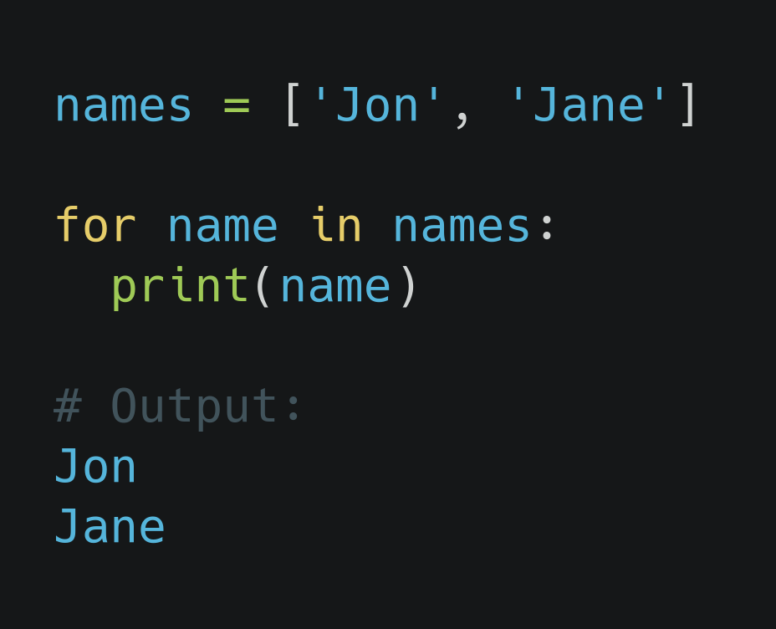
How for loop works in Python? ...

Slide 54
How for loop works in Python? ...
At first, for loop creates an iterator object internally, by calling iter() function on iterable.
After that, the while loop repeatedly calls next() function on iterator to retrieve values from it
When the next() function finishes returning items from iterator, it raises StopIteration.
After the raise of StopIteration, the loop ends there.

Slide 55


Slide 56
Task
Print first 20 multiples of 3

Slide 57
Task
Print first 50 positive even numbers

Slide 58
Task 1
WAP to delete all the occurrences of a specified character in a given string
S = “All the occurrences of a specified character in a given string”
Input = “a”
Output = “ll occurrences of specified chrcter in given string”

Slide 59
Task 2
From the given list of integers create a number whose digits are the elements of the list.
A = [4, 2, 3, 1, 2, 5]
Result = 423125

Slide 60
Task 4
Create a new list of repeated items from a provided list:
nums = [3, 4, 2, 2, 1, 3, 3, 3]
Output = [3, 2]

Slide 61
Task 5
Check whether a number is palindrome or not
a = 121
Output = “It is a palindrome number”
A = 321
output = “It is not a palindrome number”

Slide 63
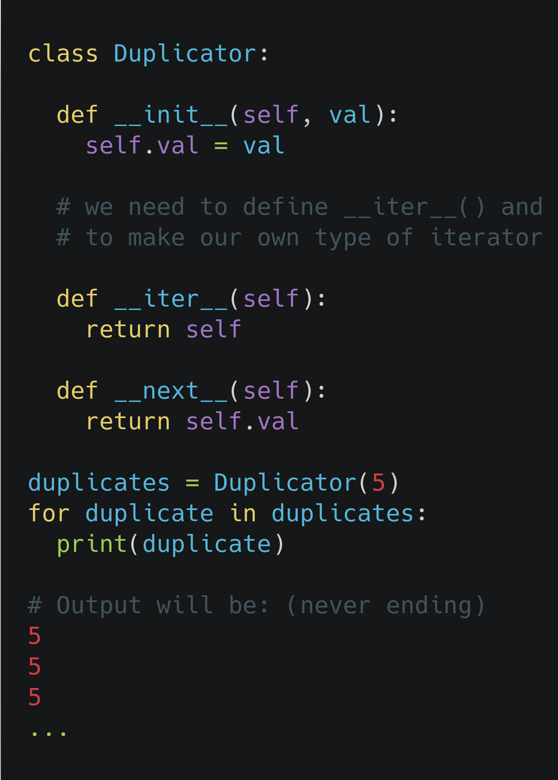
Custom Iterator in Python
Create a class from which we will be defining our iterator objects. In this case 'Duplicator'.
As mentioned in the beginning, this class must need to implement __iter__() and __next__() method
__iter__() method makes the object iterable and in this example it points to the class itself.
__next__() method preserves the previous states and returns the value w.r.t the state. In this case it is returning initialized value every time. (So, this will never stop from returning value.)
So defined class will make an infinite iterator

Slide 64
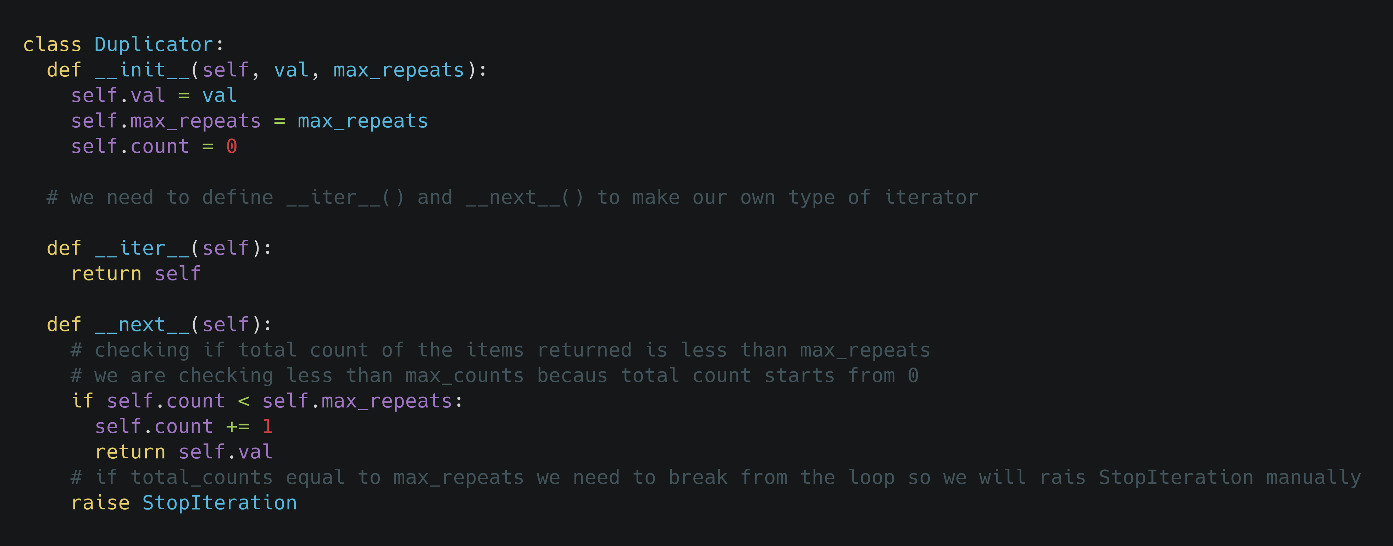
Custom Iterator in Python ...
User defined iterator class

Slide 65
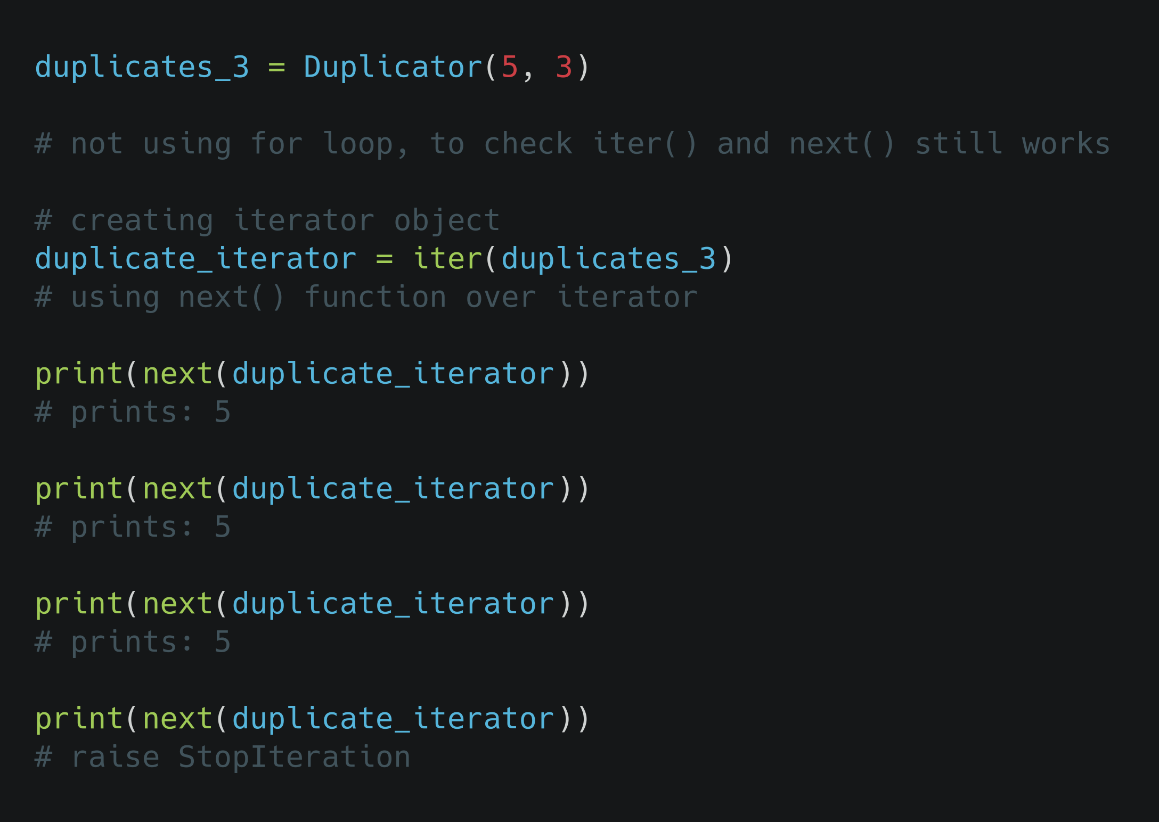
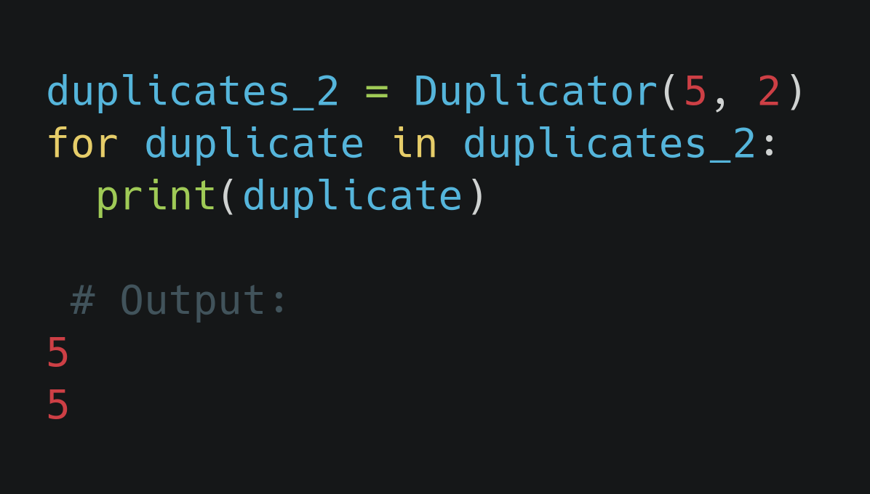
Custom Iterator in Python ...
Once the total count of max_repeats reached, then the __next__() method will raise StopIteration and this exception is caught by for loop internally and terminates the loop.
Iterating through a user defined iterator class Duplicator

Slide 66
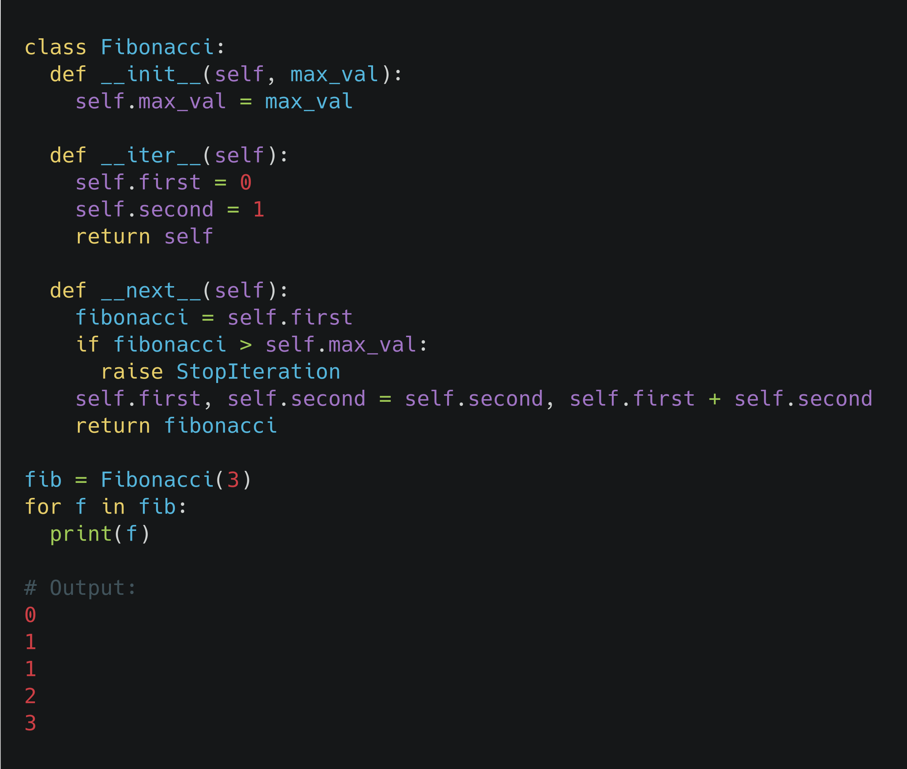
User Defined Iterator (Fibonacci series)

Slide 67
Generator in Python
Generator are simplified iterators (elegant kind of iterator)
Generator allows you to write iterators in an elegant syntax, it avoid writing classes with __iter__() and __next__() methods.
NOTE: Any generator also is an iterator(not vice versa)

Slide 68
Creating Generators in Python
A generator can be created by defining a function which will use yield statement instead of return statement.
yield statement also returns value but in a slightly different way than the return statement
return statement terminates a function on one function call whereas yield statement keeps track of current states and resumes from the place where it left on successive function call.
A generator function contains at least one yield statement and can have any number of other yield statements or return statements.
StopIteration is raised on further function call once the function terminates.

Slide 69
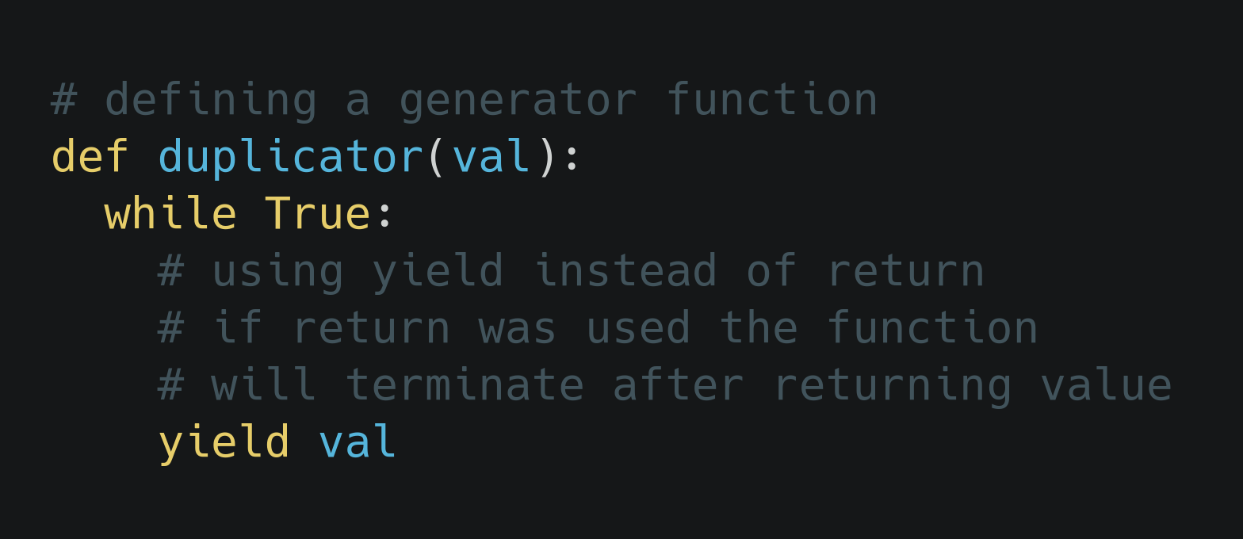
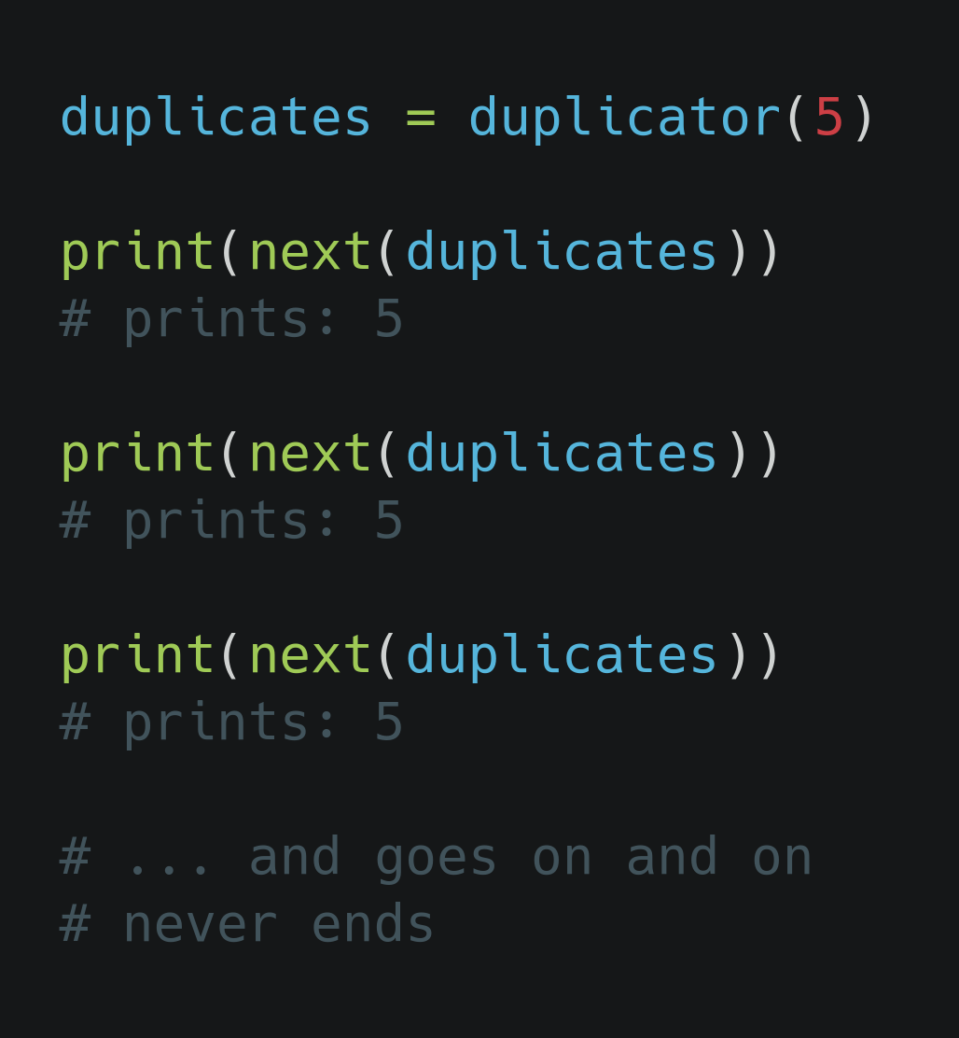
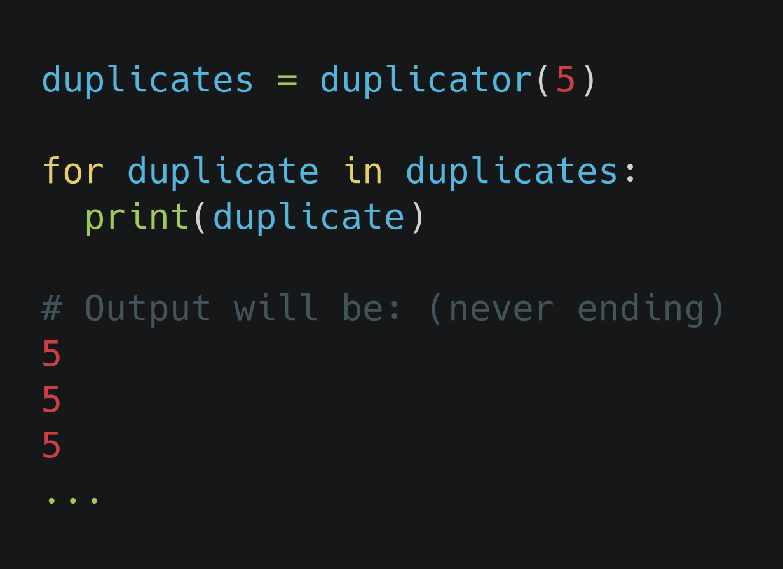
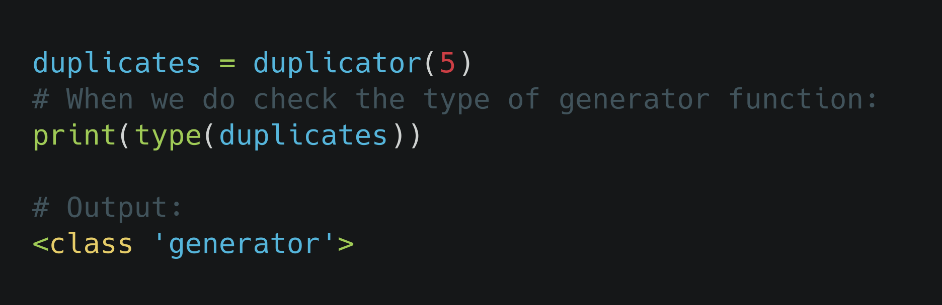
Creating Generators in Python ...
We will get started by creating a simplest infinite generator:
next() function works just like in the iterators from previous topics.

Slide 70
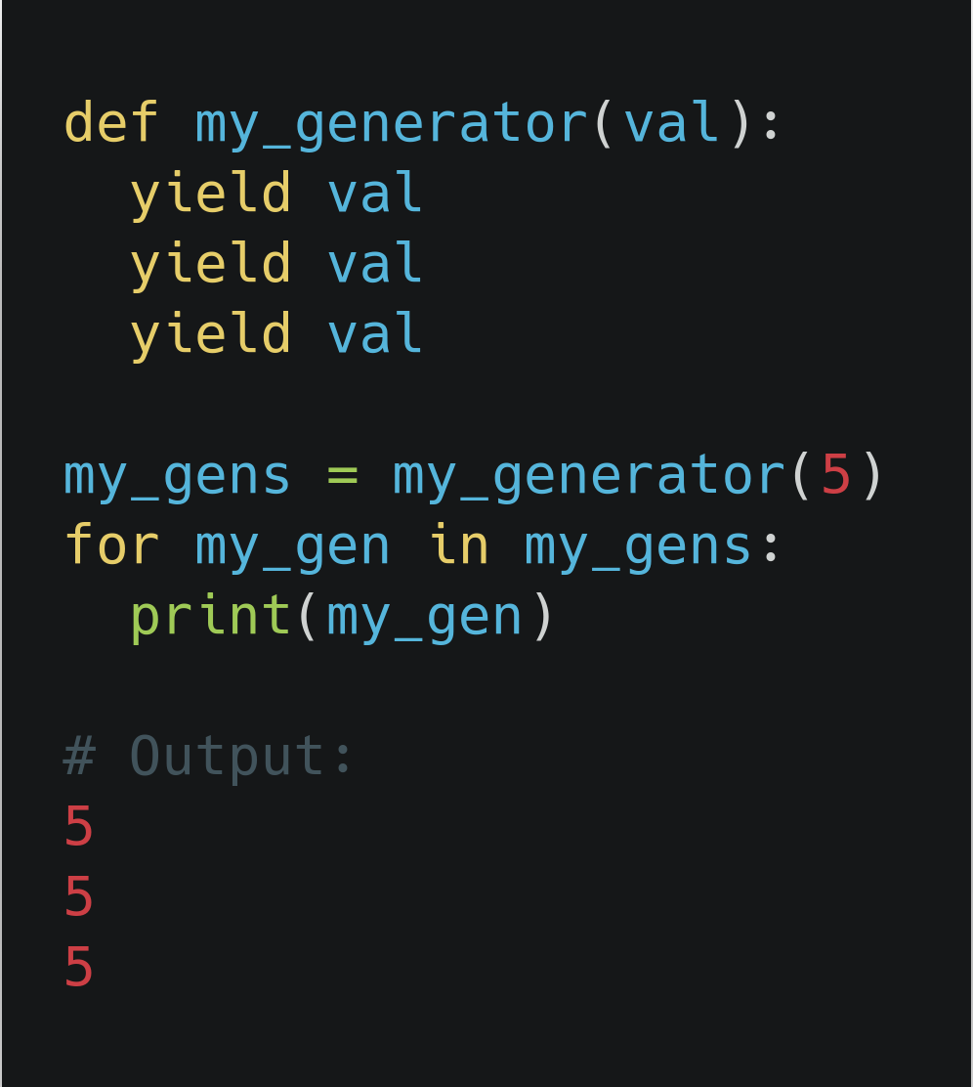
Python Generators (example)...
We have seen how we can create a simple infinite generators. In this example we will create finite generator:
Creating finite generator this way is not
recommended. We will have a look into
next slide for a proper use case.

Slide 71
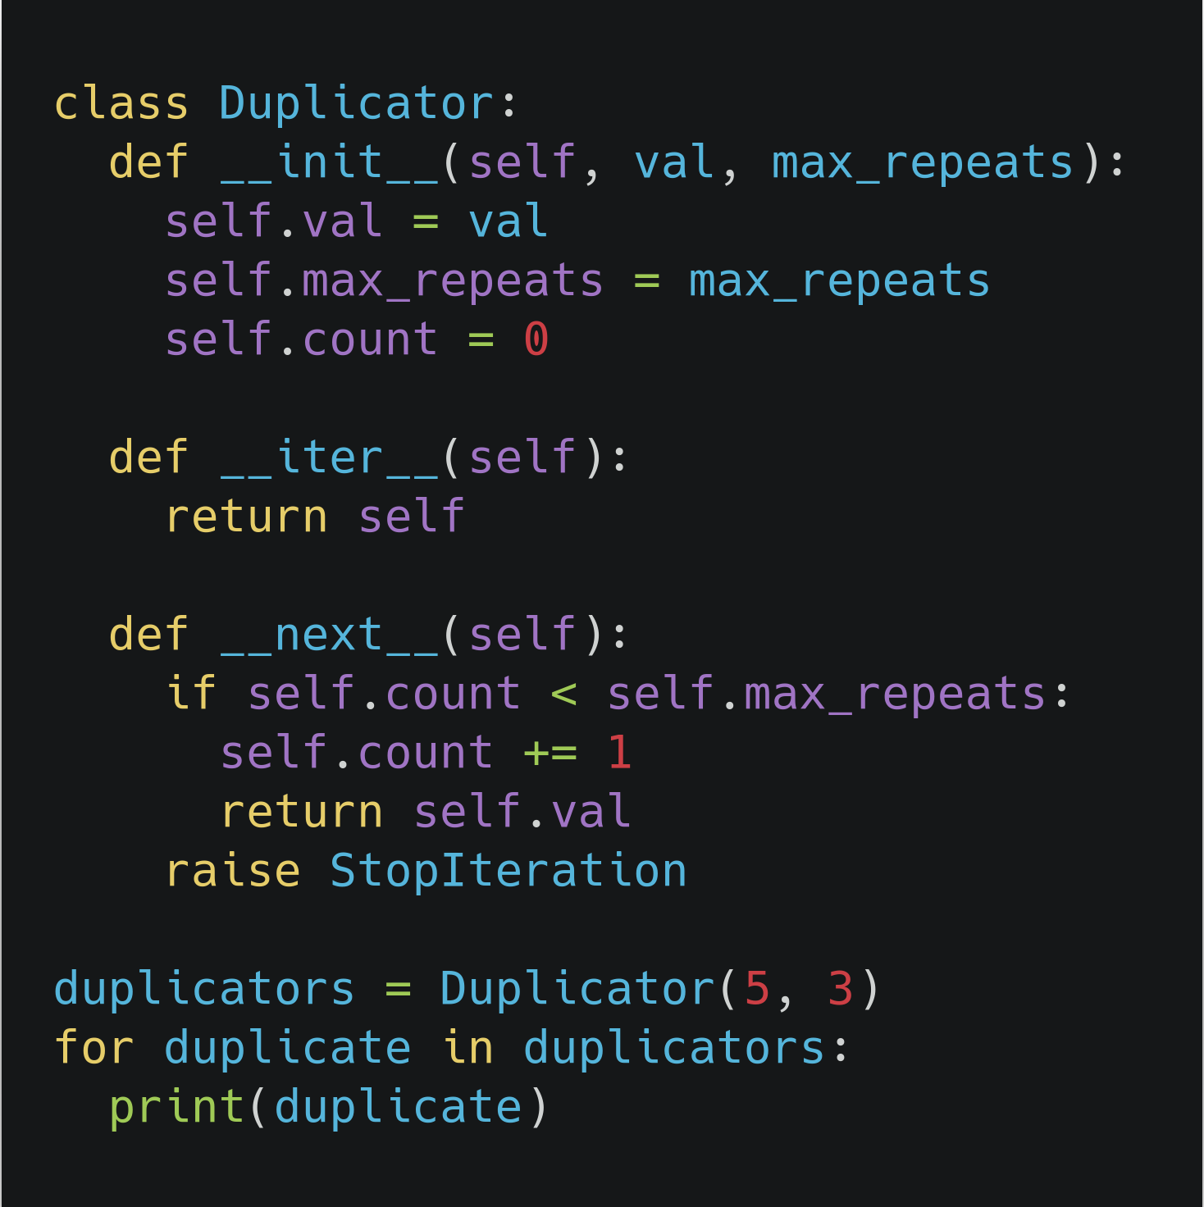
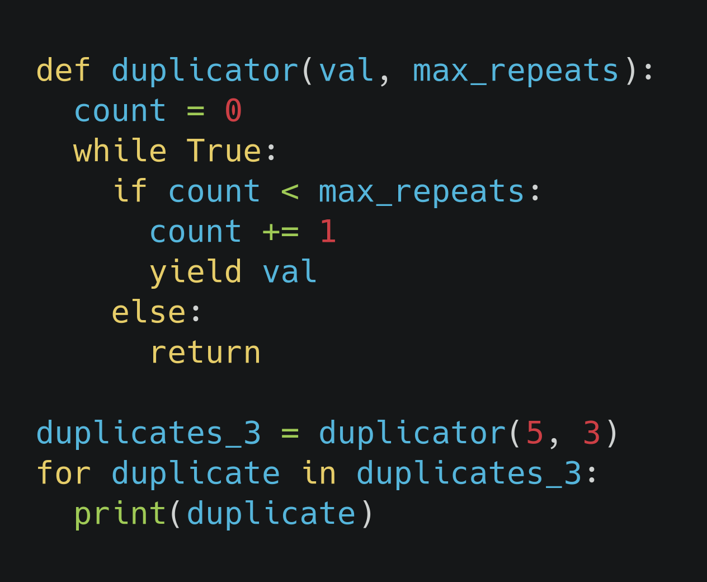
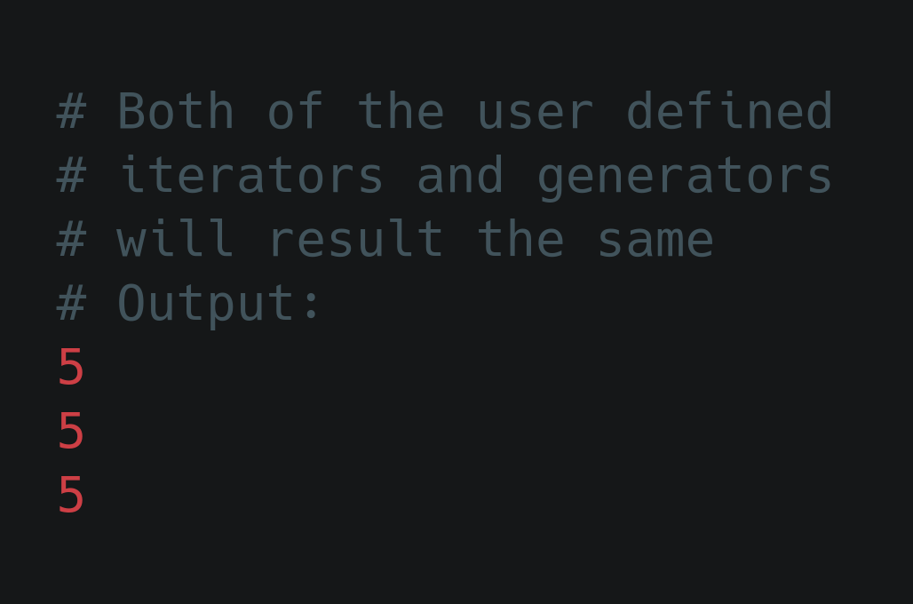
Python Generators (example)...
We will compare the Duplicator iterator class from the slide on Python Iterators with our new user defined generator side by side as below:
Output of User defined iterator and generator
User defined generator in action
User defined Iterator in action

Slide 72
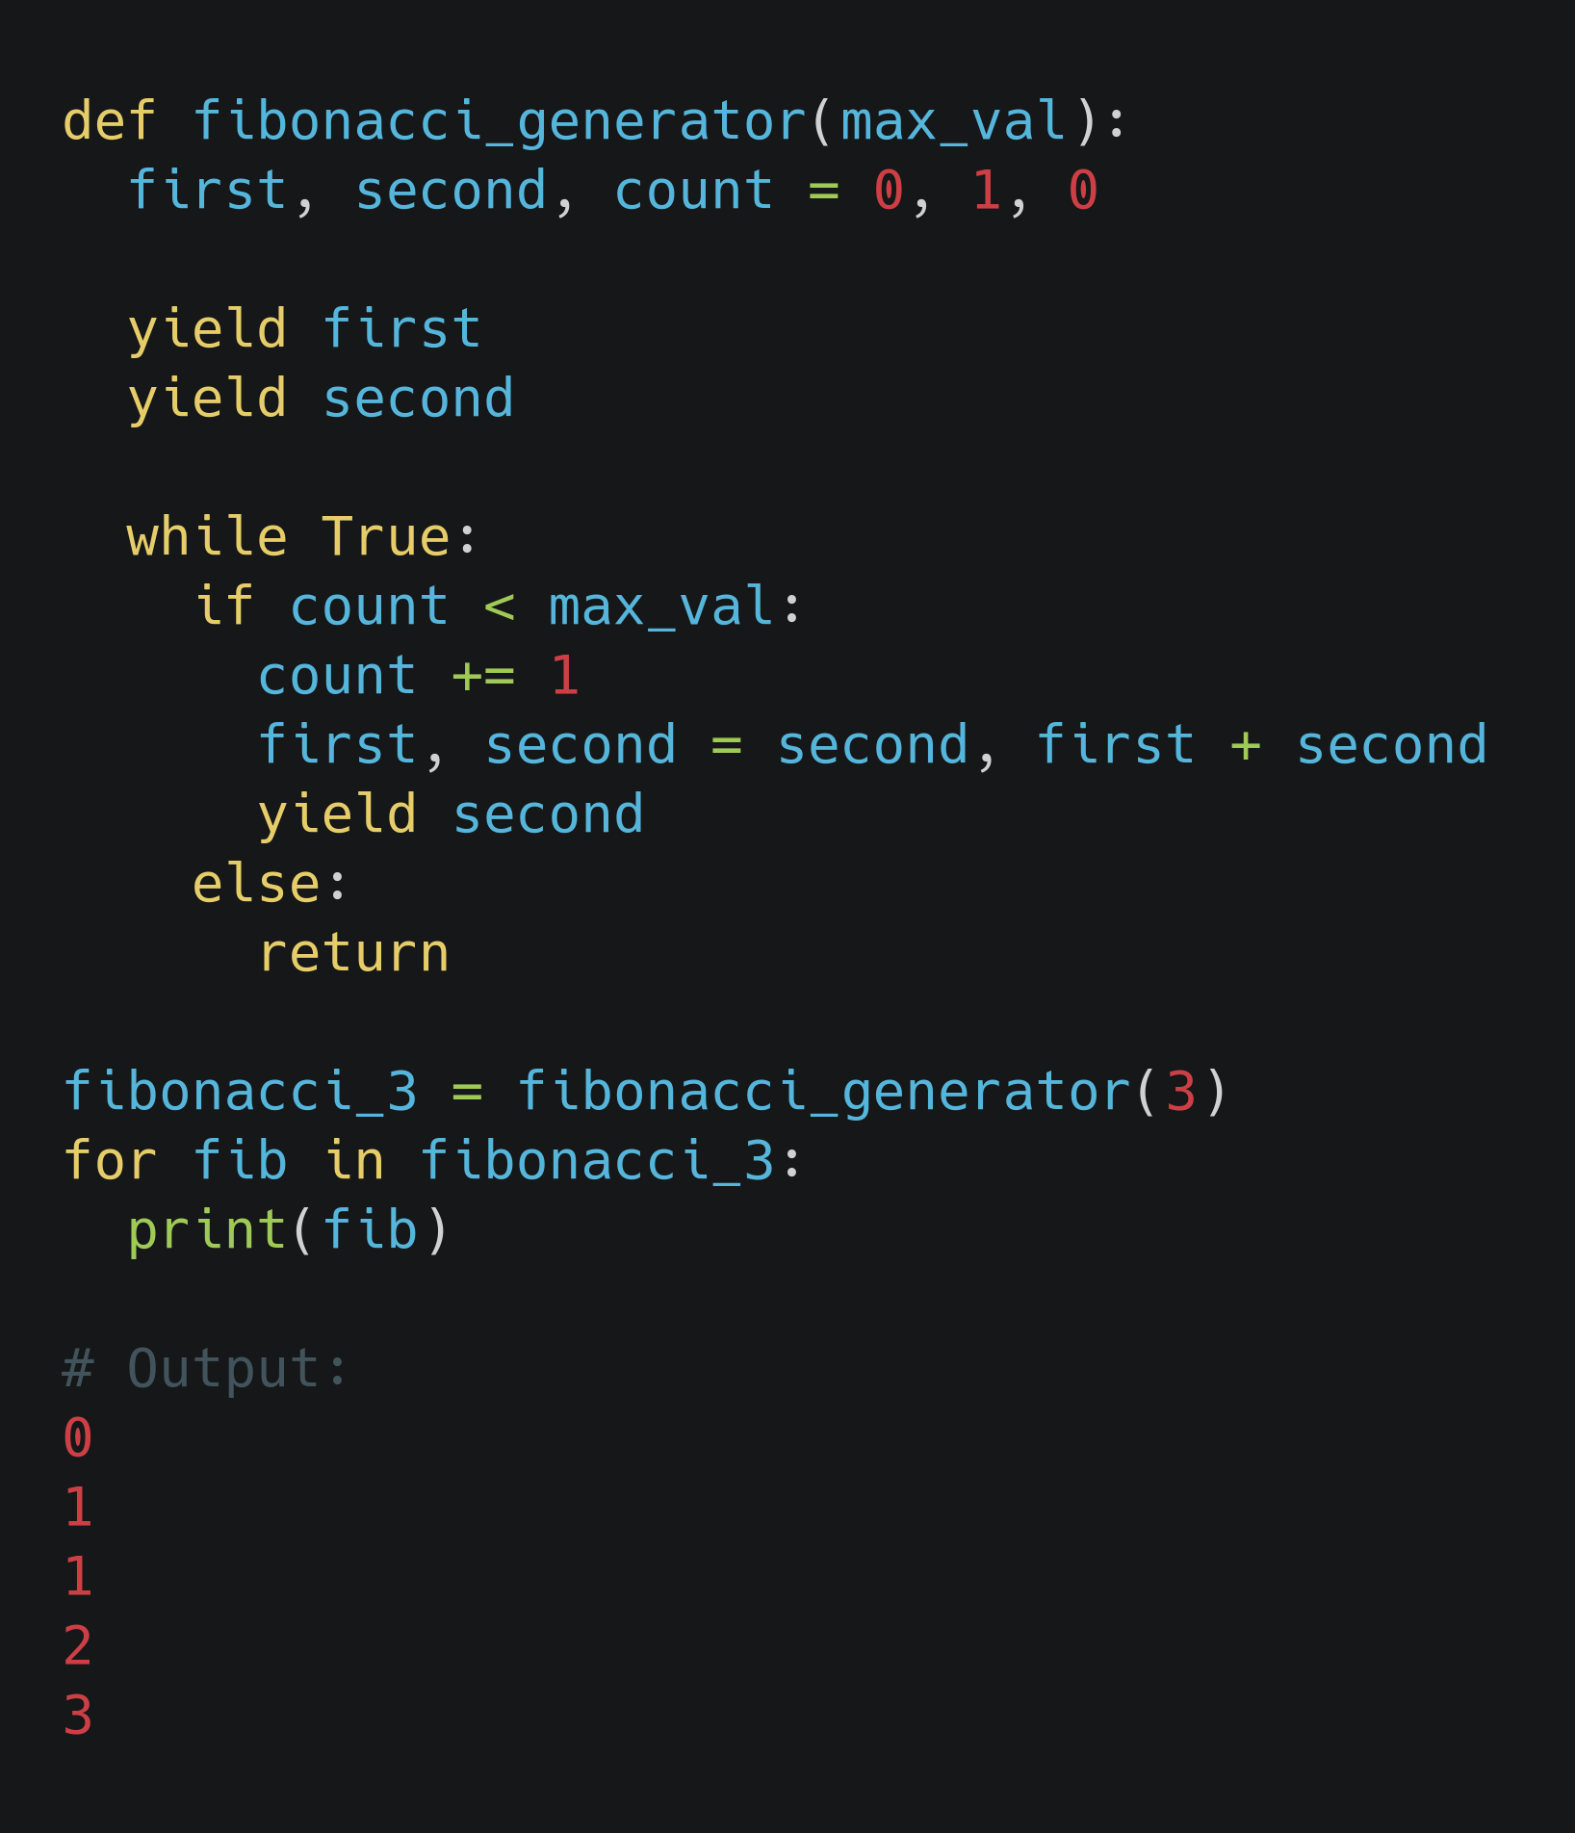
Generator function (Fibonacci series)
Similar way we did in the user defined iterators, we can easily create the generators for Fibonacci series:

Slide 73
Generator expression
Generator expressions provide an effective shortcut for writing iterators.
All generator topics covered till this slide were basically the generator functions.
Generator expression adds another layer of syntactic sugar on top of generator function.
Generator expressions generate values “just in time” like a class-based iterator or a generator function would, they are very memory efficient.

Slide 74
Generator expression ...
Like the lambda function creates anonymous function, generator expression creates an anonymous generator function.
In simple generator expression is a type of generator which is equivalent of list comprehension.
A generator expression is like the list comprehension but, the square brackets are replaced by round parenthesis.
Generator expressions are memory efficient than an equivalent list comprehension

Slide 75
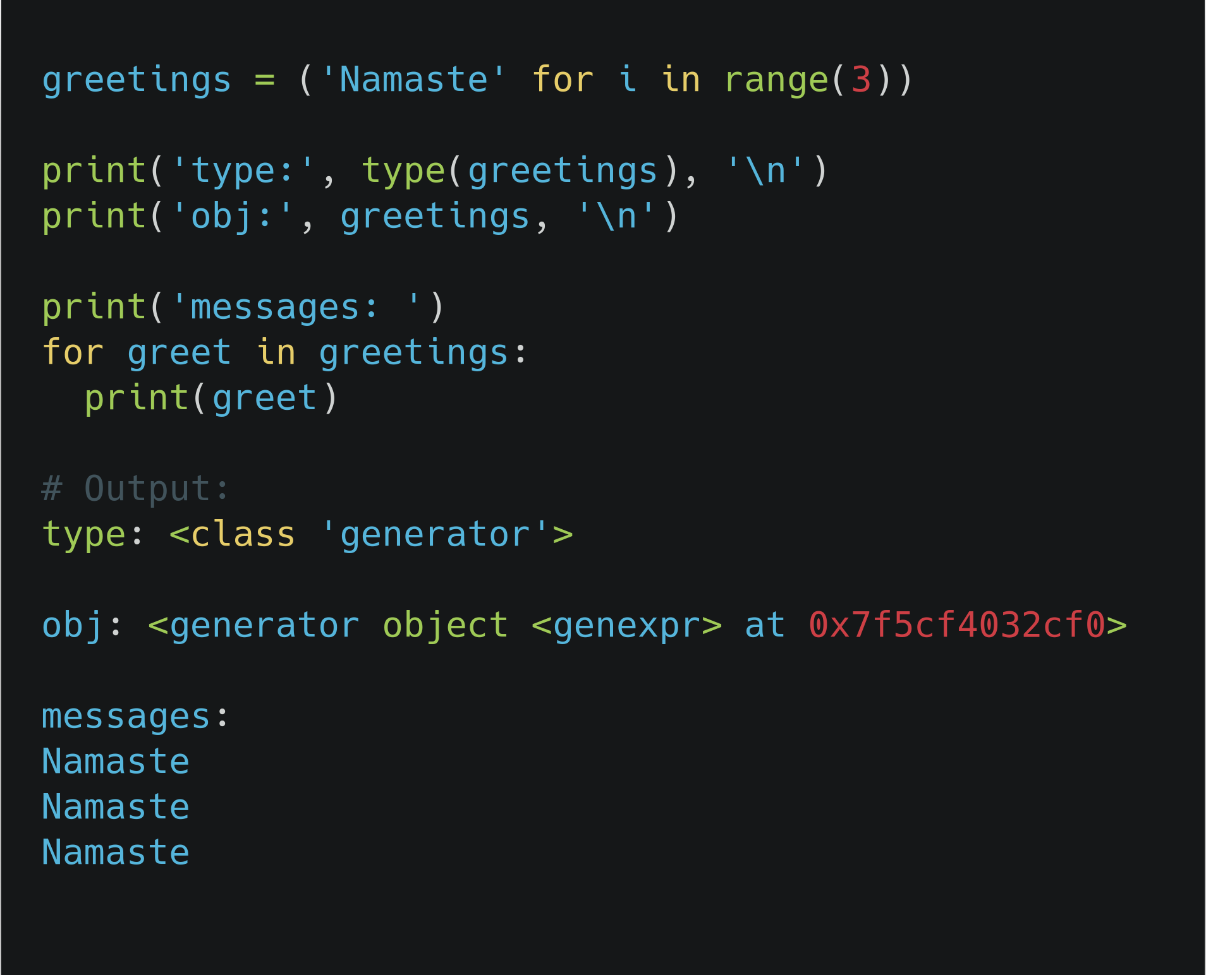
Generator expression (example)...
Generator expression example with its type and class name

Slide 76
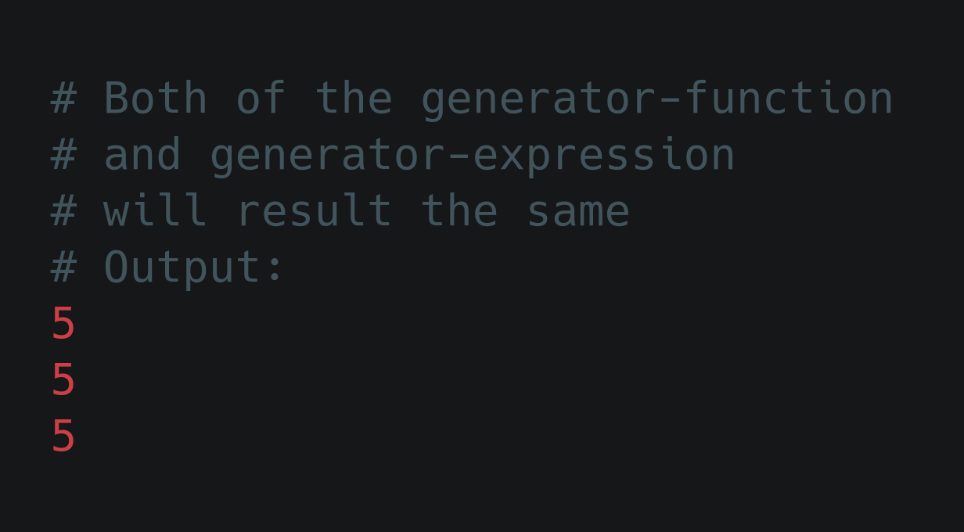
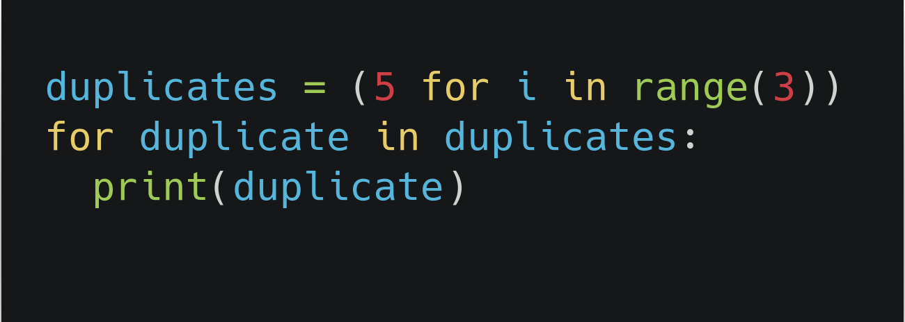
Generator expression (example)...
Output of generator function
& generator expression
Generator expression
Generator function

Slide 77
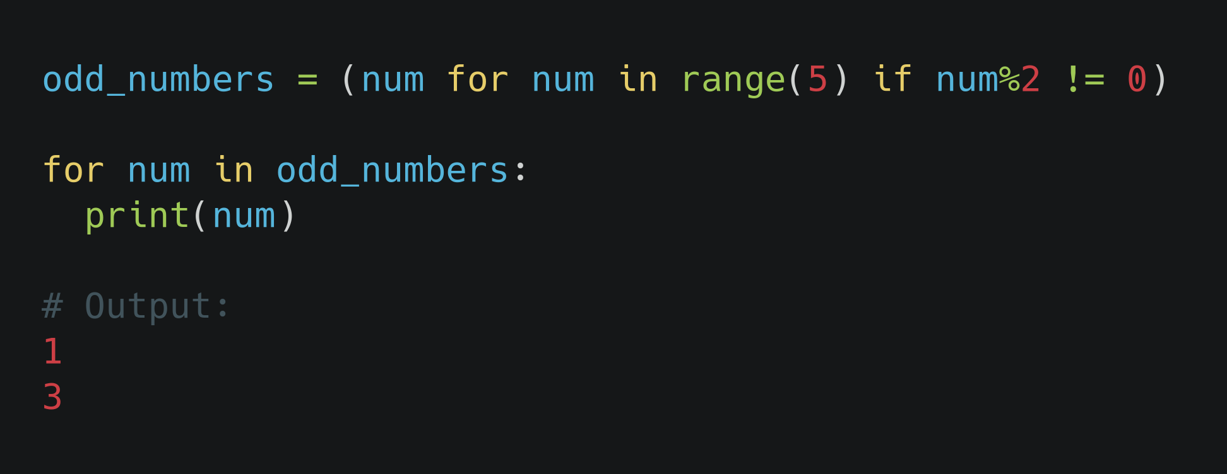
Generator expression (conditional)

Slide 78
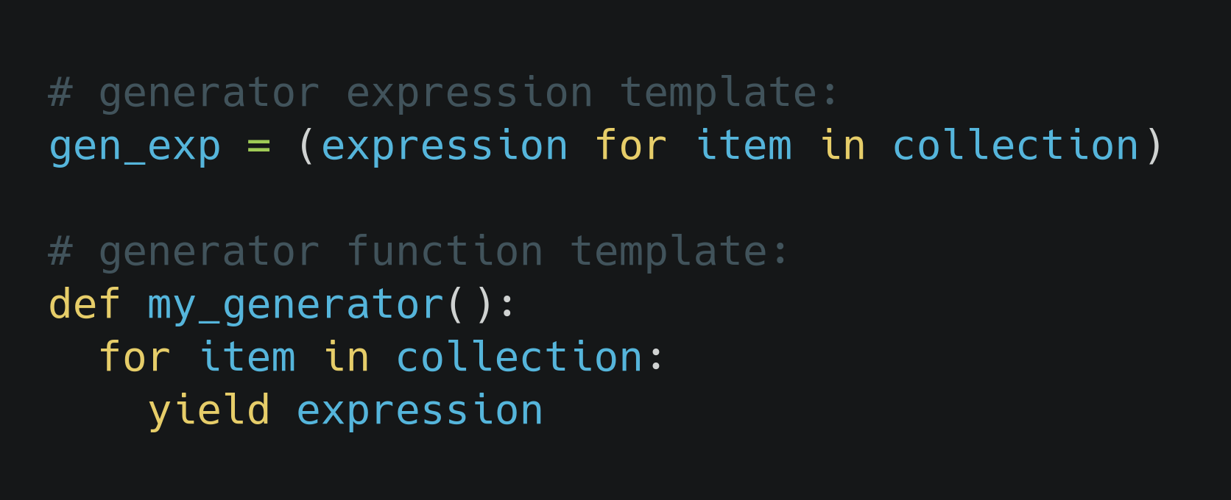
Generator expressions and Generator functions
Generator function and Generator expression templates

Slide 79
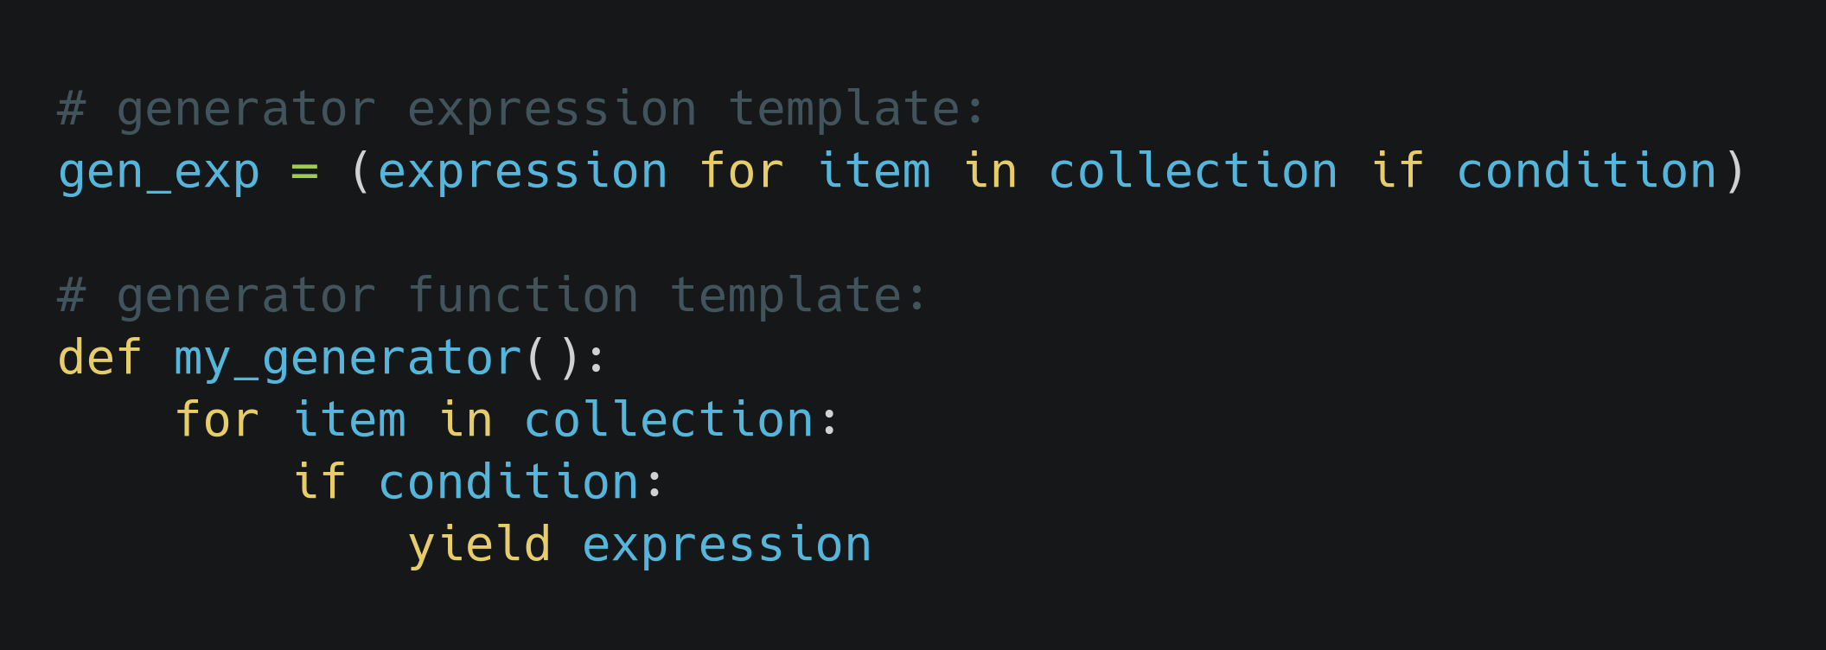
Generator expressions and Generator functions (conditional)
Generator function and Generator expression templates (conditional)

Slide 80
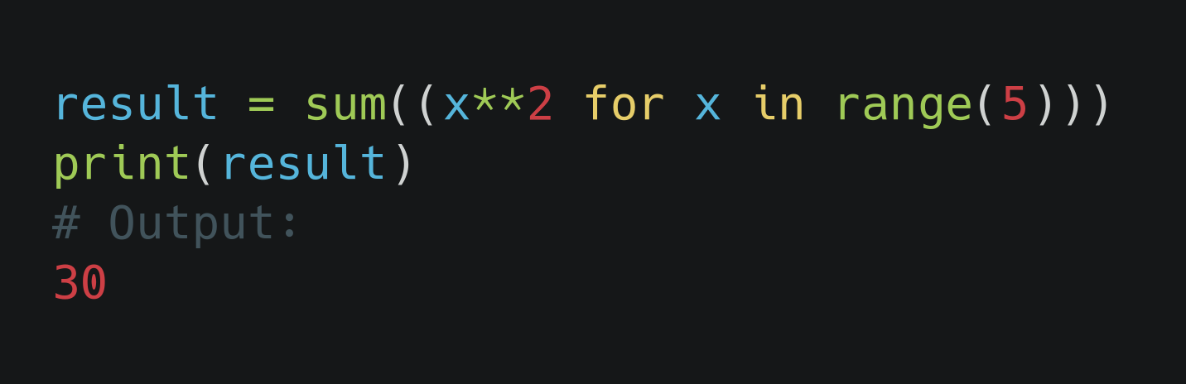
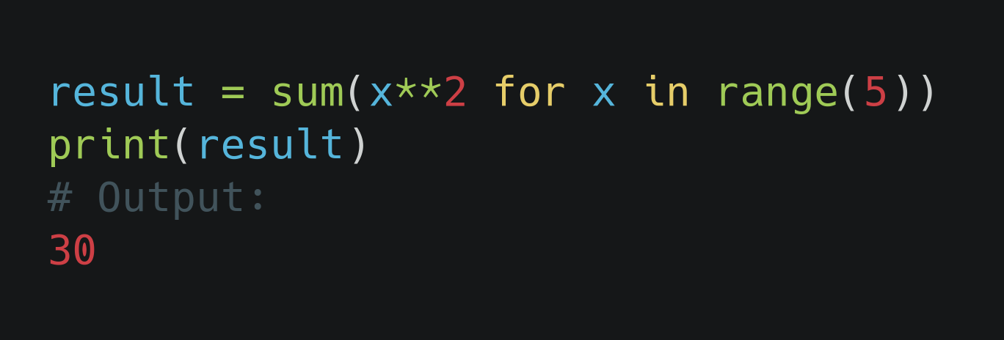
One last look at Generator expressions
If a generator expression is used as the single argument to a function, then the parenthesis surrounding a generator expression can be ignored.
Generator expression with double parenthesis passed as function argument
Generator expression with removed a pair of parenthesis to make beautiful and clean function argument

Slide 81
Good practice on writing beautiful generator expression
There is no specific rule to follow how deep your generator expression can be nested.
We would recommend generator expression that is not more than two levels of nesting.
It would be easy to maintain in the future
It would be easy to understand what we are going to do with the generator expression
For complex iterators, it is better to write a generator function or even a class-based iterator chains.
We will cover chaining of generator in next slide.

Slide 82
Chain of generators
Chaining together multiple generators
Generators can be chained together to form highly efficient and maintainable data processing pipelines.
We chain multiple generators in a sequence so that the yielded result of a generator is passed to another generator for processing.
Inside chaining of generators, the data processing happens one element at a time.

Slide 83
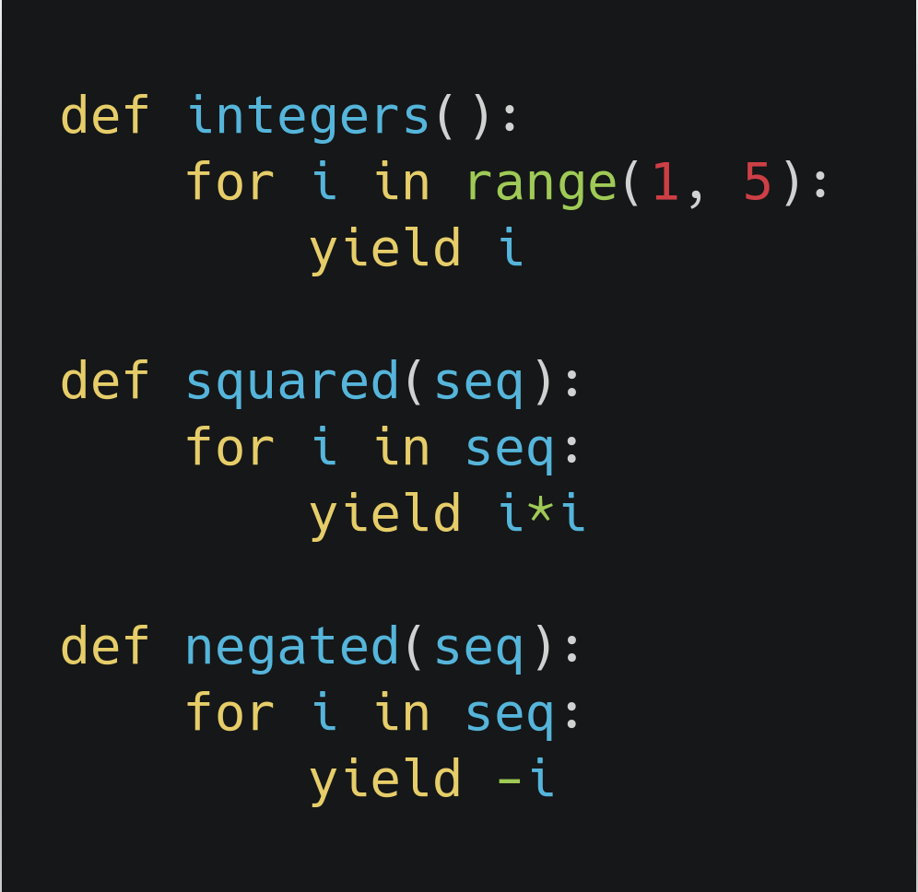
Chain of generators (example)
We will define three generator function to illustrate the example:
Generator function definition

Slide 84
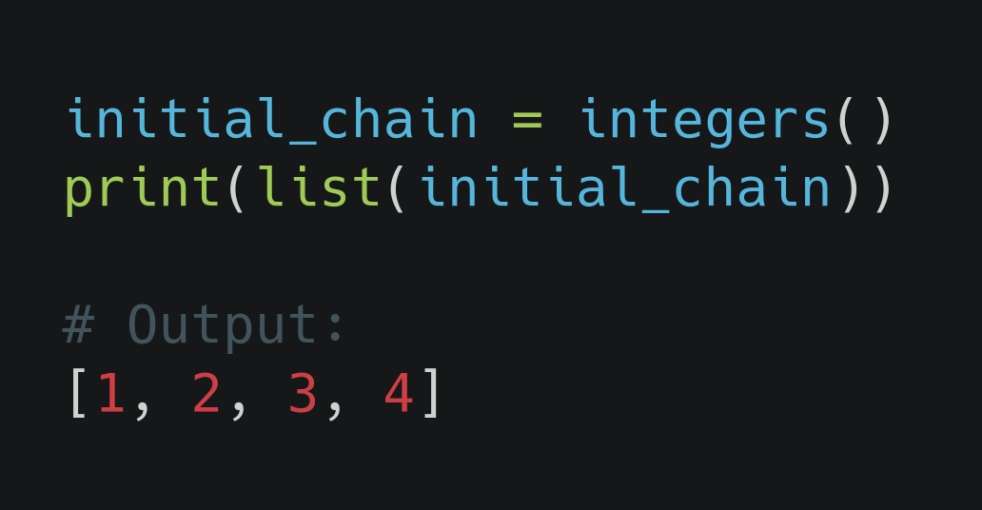
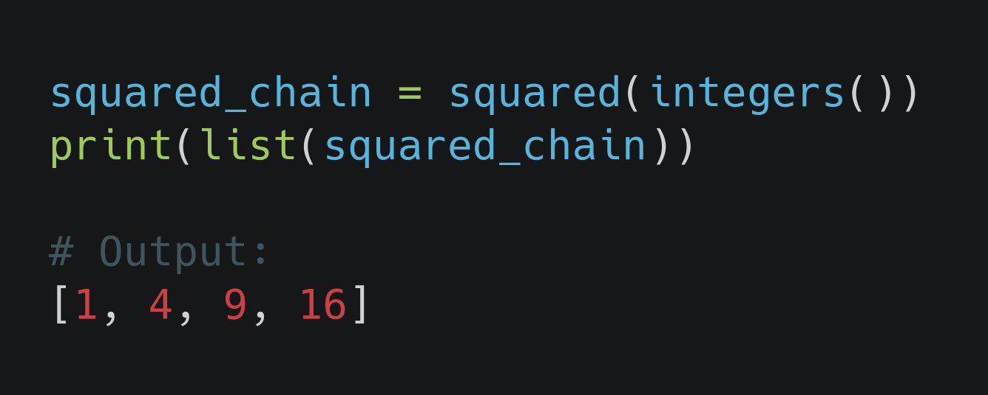
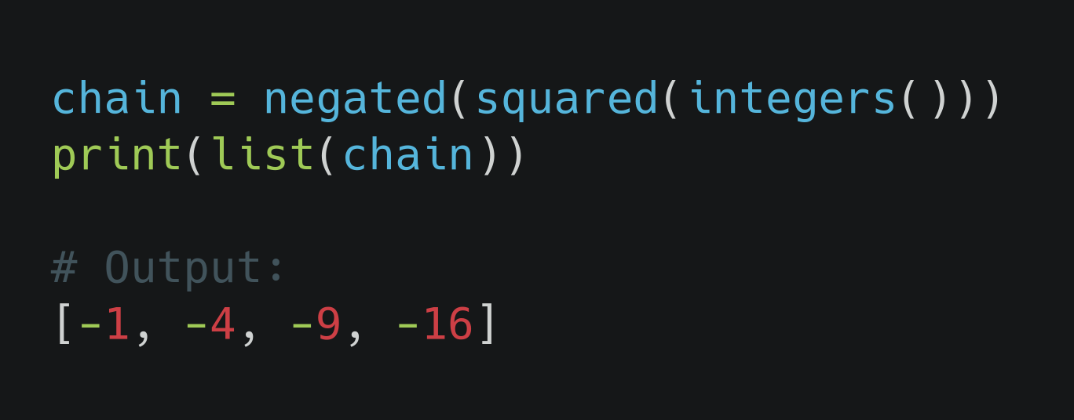
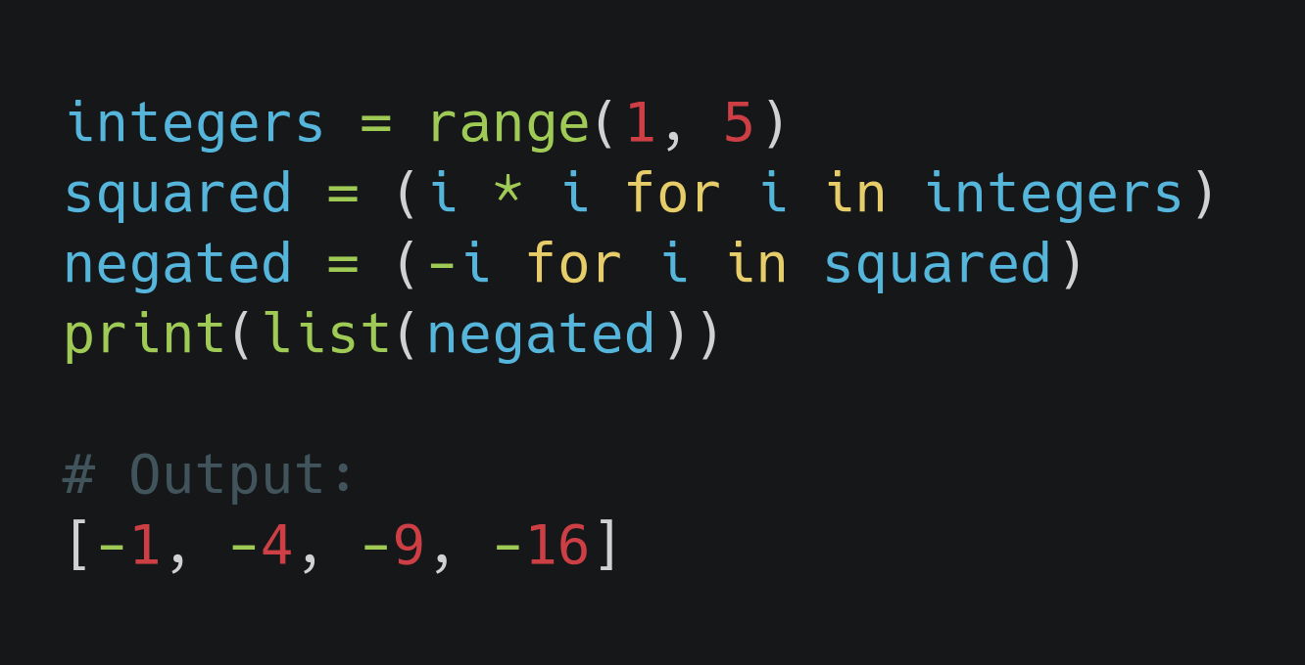
Chain of generators (example)
i.
ii.
iii.
iv.

Slide 85
Chain of generators (example)...
i. At this moment we hadn't introduced to the chaining of generators yet.
We will feed the data stream coming from integers() generator into another generator
ii. We will divide things down how the squared generator works:
At first integers generator yields a single value, let's say 2
This “activates” the squared generator, which processes the value and passes it on to the next stage as 2 × 2 = 4

Slide 86
Chain of generators (example)...
iii. We will divide things down how the negated generator works:
The same flow goes as mentioned in step (ii) up to squared generator
The square number yielded by the squared generator from above point is passed to the negated generator immediately, which modifies it to –4 and yields it again.
iv. A generator expression is built based on previous expressions and it replaces the individual processing steps in the chain.
This code is equivalent to that of step(iii)

Slide 87
Is generator expression better than generator function in generator chaining?
Generator expression cannot be configured with function arguments
We can't reuse the same generator expression multiple times in the same processing pipeline.
We can use the mix of generator expression and generator function

Slide 88
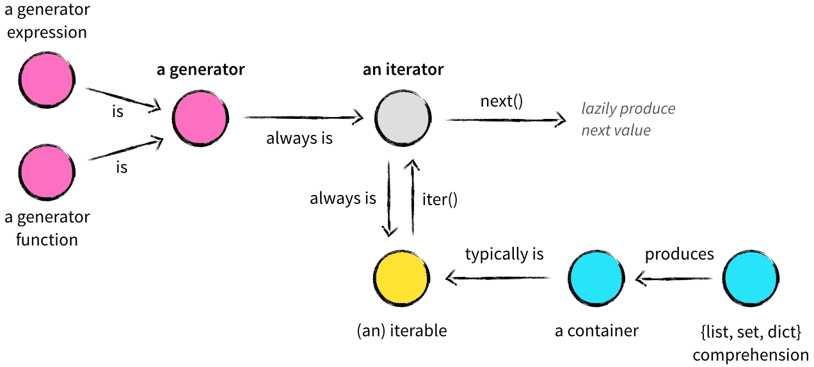
Iterators, Iterables, Generators in a nutshell

Slide 89
References
Python Tricks: A Buffet of Awesome Python Features
https://nvie.com/posts/iterators-vs-generators/
https://dbader.org/blog/python-iterator-chains

